Slide 1
Scrom testing

Slide 2
This is too test scrom engine Please tell me the exact error message from your browser console (F12) or your Python terminal so we can trace the crash.
That is definitely a roadblock, but because we just rebuilt the export engine, the failure is likely happening for one of these specific reasons:
Payload Size Limit: Because the new PPTX parser extracts images as raw Base64 text strings, a presentation with a lot of high-resolution images will create a massive JSON payload. When you click Export, sending 50MB+ of text back to the FastAPI server might be triggering a server limit or a timeout.
Missing Metadata: If the PPTX parser grabbed a shape or placeholder that doesn't cleanly fit into our CourseData JSON structure, the backend might be rejecting the request with a 422 Unprocessable Entity error.
How to isolate this right now:
If the UI says "Failed to export": Press F12, go to the Console tab, and tell me what the red text says (e.g., Server Error 422 or Payload Too Large).
If it spins forever: Check your Python terminal to see if it threw a 500 Internal Server Error or an Out of Memory warning.
If the ZIP downloads but the PPTX content is missing inside: Let me know, as that means the Python HTML renderer is ignoring the specific way the PPTX blocks are formatted.
Paste whatever error you are seeing, and I will give you the exact fix.

Slide 3
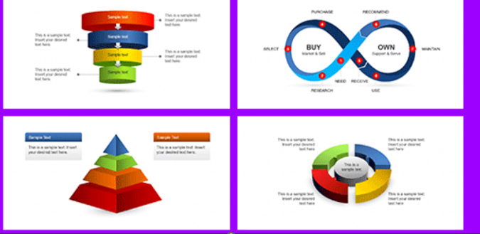


Slide 4
Please tell me the exact error message from your browser console (F12) or your Python terminal so we can trace the crash.
That is definitely a roadblock, but because we just rebuilt the export engine, the failure is likely happening for one of these specific reasons:
Payload Size Limit: Because the new PPTX parser extracts images as raw Base64 text strings, a presentation with a lot of high-resolution images will create a massive JSON payload. When you click Export, sending 50MB+ of text back to the FastAPI server might be triggering a server limit or a timeout.
Missing Metadata: If the PPTX parser grabbed a shape or placeholder that doesn't cleanly fit into our CourseData JSON structure, the backend might be rejecting the request with a 422 Unprocessable Entity error.
How to isolate this right now:
If the UI says "Failed to export": Press F12, go to the Console tab, and tell me what the red text says (e.g., Server Error 422 or Payload Too Large).
If it spins forever: Check your Python terminal to see if it threw a 500 Internal Server Error or an Out of Memory warning.
If the ZIP downloads but the PPTX content is missing inside: Let me know, as that means the Python HTML renderer is ignoring the specific way the PPTX blocks are formatted.
Paste whatever error you are seeing, and I will give you the exact fix.

Slide 5
Please tell me the exact error message from your browser console (F12) or your Python terminal so we can trace the crash.
That is definitely a roadblock, but because we just rebuilt the export engine, the failure is likely happening for one of these specific reasons:
Payload Size Limit: Because the new PPTX parser extracts images as raw Base64 text strings, a presentation with a lot of high-resolution images will create a massive JSON payload. When you click Export, sending 50MB+ of text back to the FastAPI server might be triggering a server limit or a timeout.
Missing Metadata: If the PPTX parser grabbed a shape or placeholder that doesn't cleanly fit into our CourseData JSON structure, the backend might be rejecting the request with a 422 Unprocessable Entity error.
How to isolate this right now:
If the UI says "Failed to export": Press F12, go to the Console tab, and tell me what the red text says (e.g., Server Error 422 or Payload Too Large).
If it spins forever: Check your Python terminal to see if it threw a 500 Internal Server Error or an Out of Memory warning.
If the ZIP downloads but the PPTX content is missing inside: Let me know, as that means the Python HTML renderer is ignoring the specific way the PPTX blocks are formatted.
Paste whatever error you are seeing, and I will give you the exact fix.

Slide 6
